Slide 1

Sales Data Analysis
Tools Used : SQL , PgAdmin4 , ChatGPT
This Photo by Unknown Author is licensed under CC BY

Slide 2
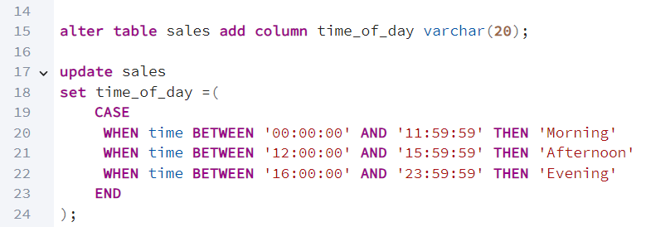
Altering the table to add a new column.

Slide 3
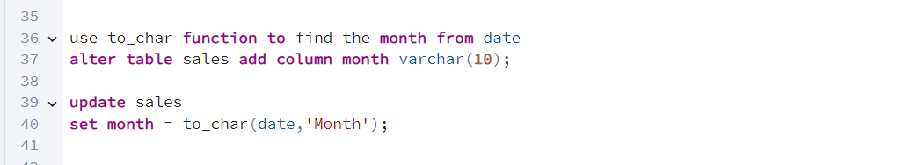
Using ‘to_char’ function to extract month from date

Slide 4
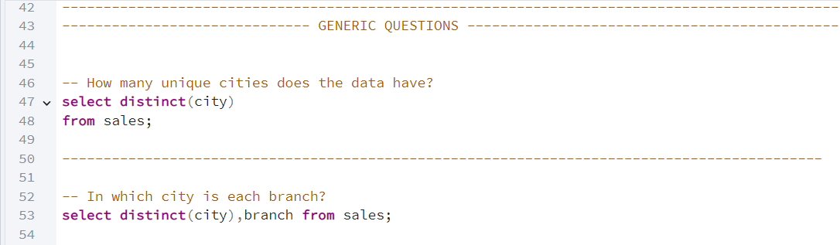
Some Generic Questions

Slide 5
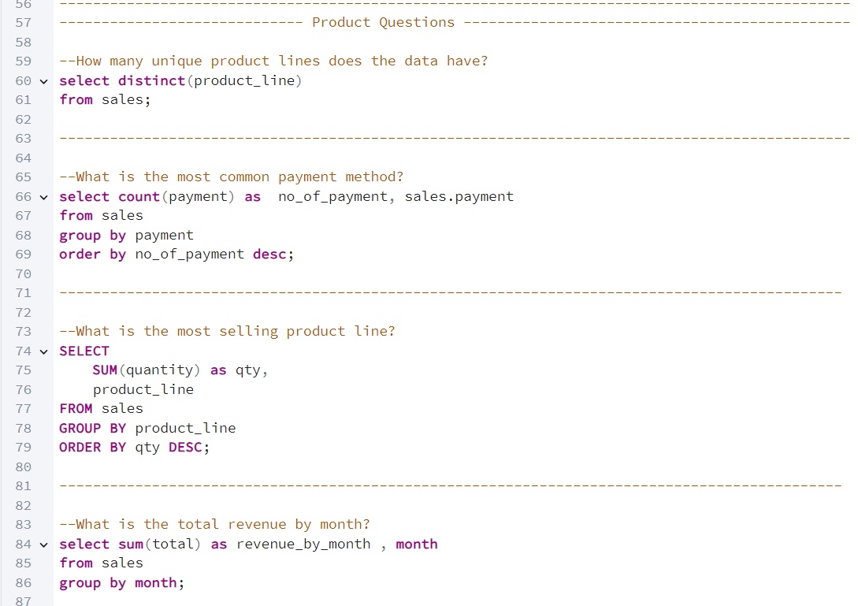
Products related questions Using ‘Group By’ and ‘Order By’ clause

Slide 6
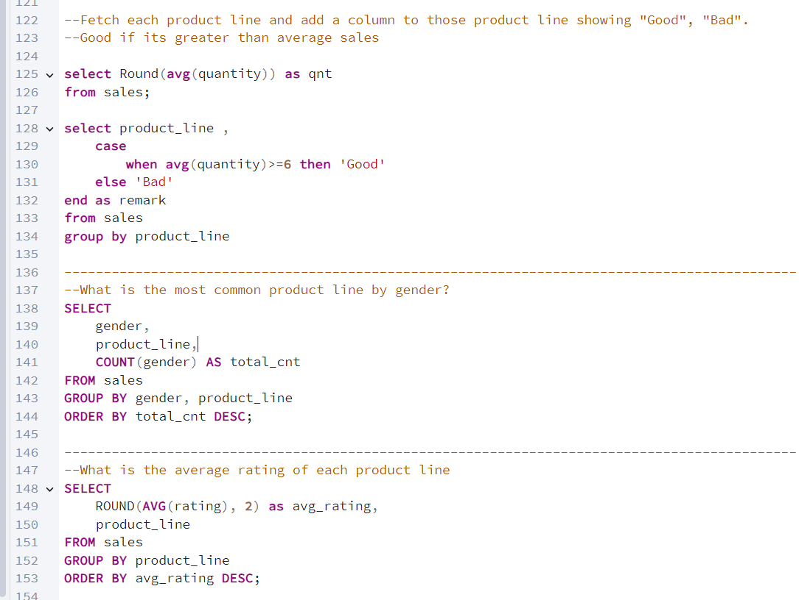

Slide 7
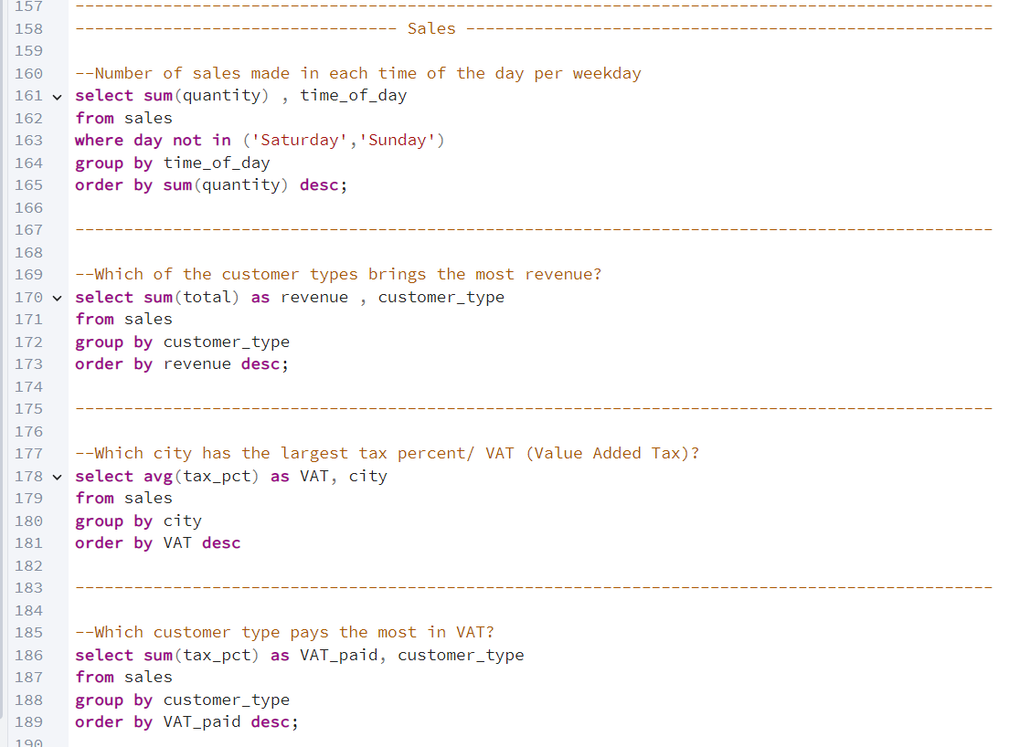
Sales questions

Slide 8
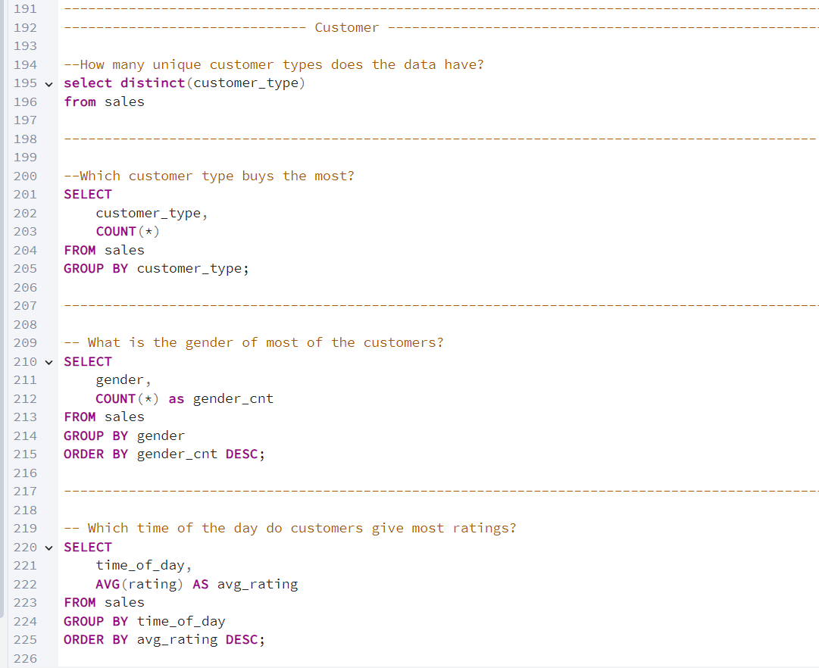
Customer Related

Slide 9
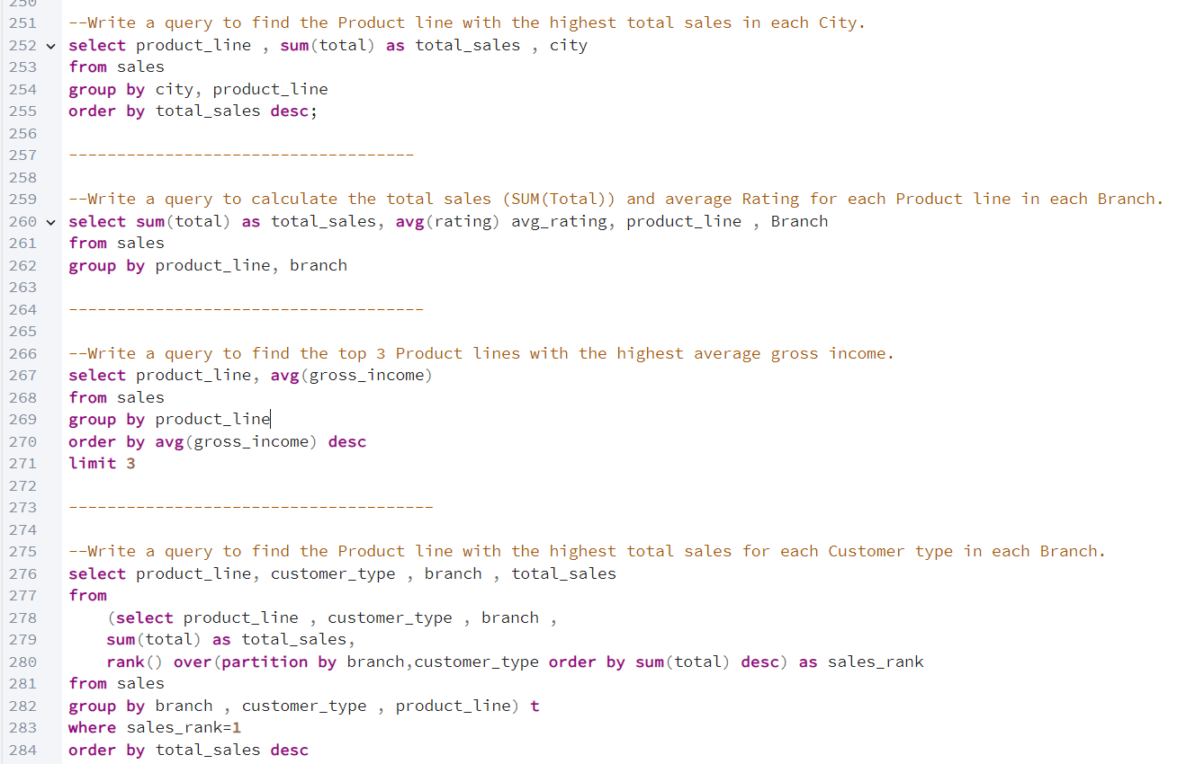
ChatGPT Questions

Slide 10
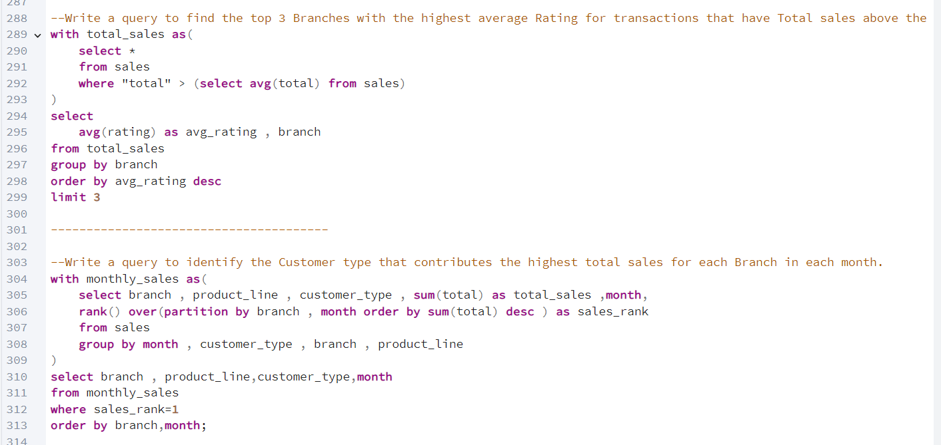
ChatGPT 2

Slide 11
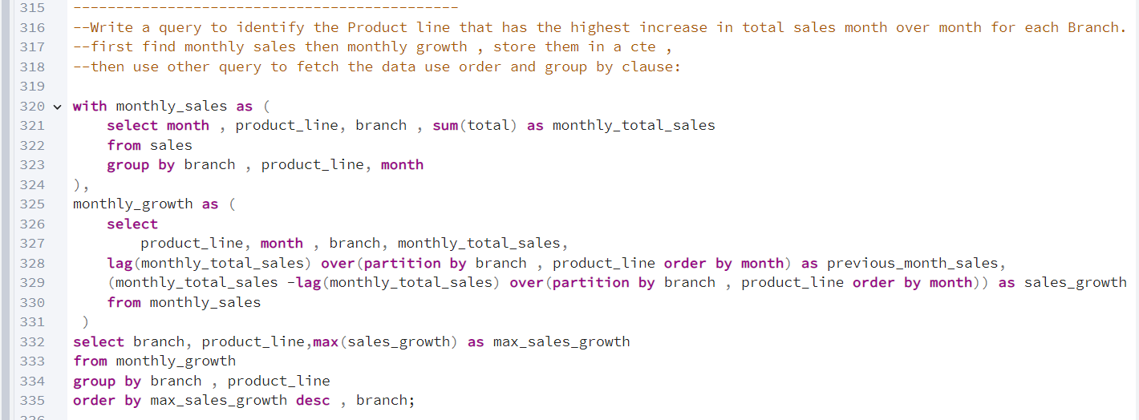
ChatGPT 3

